Slide 1
Recap Web Fundamentals Project
Ghada Chatti

Slide 2
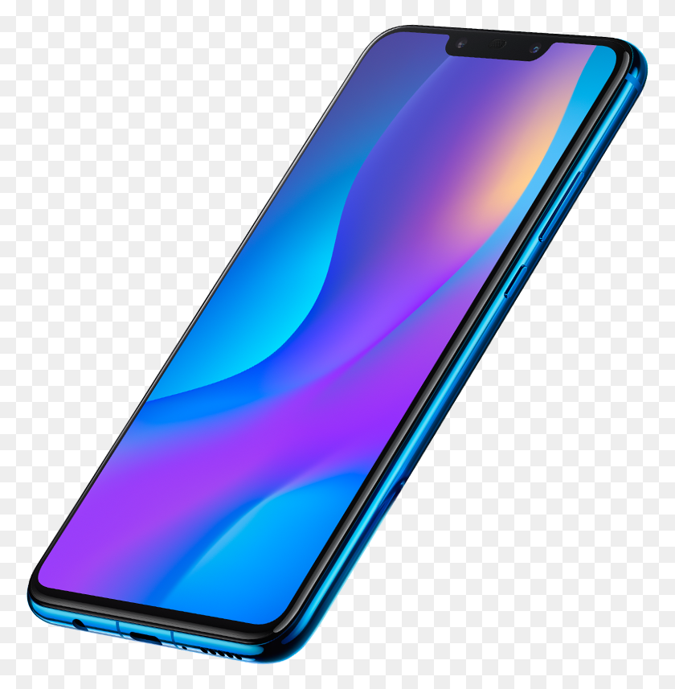

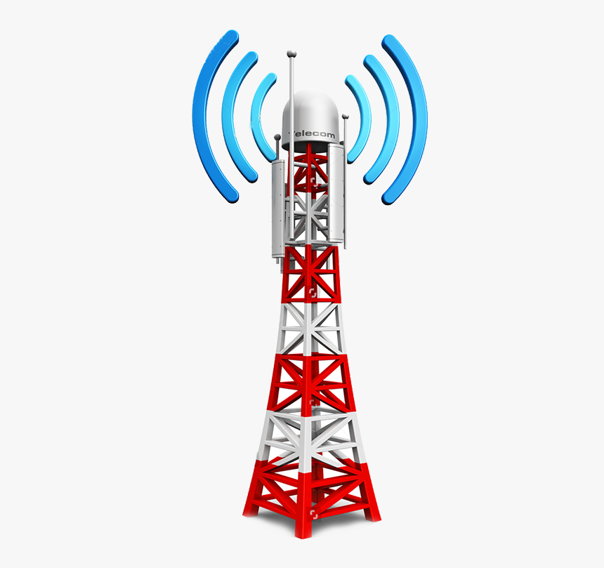
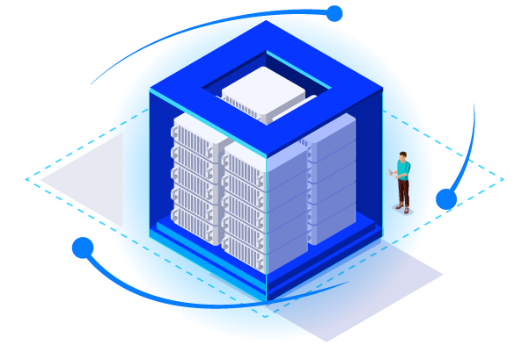
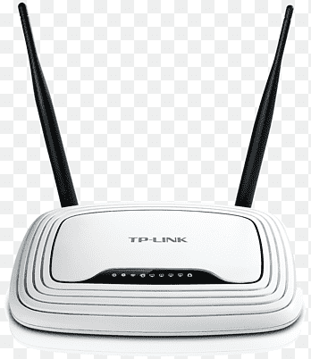
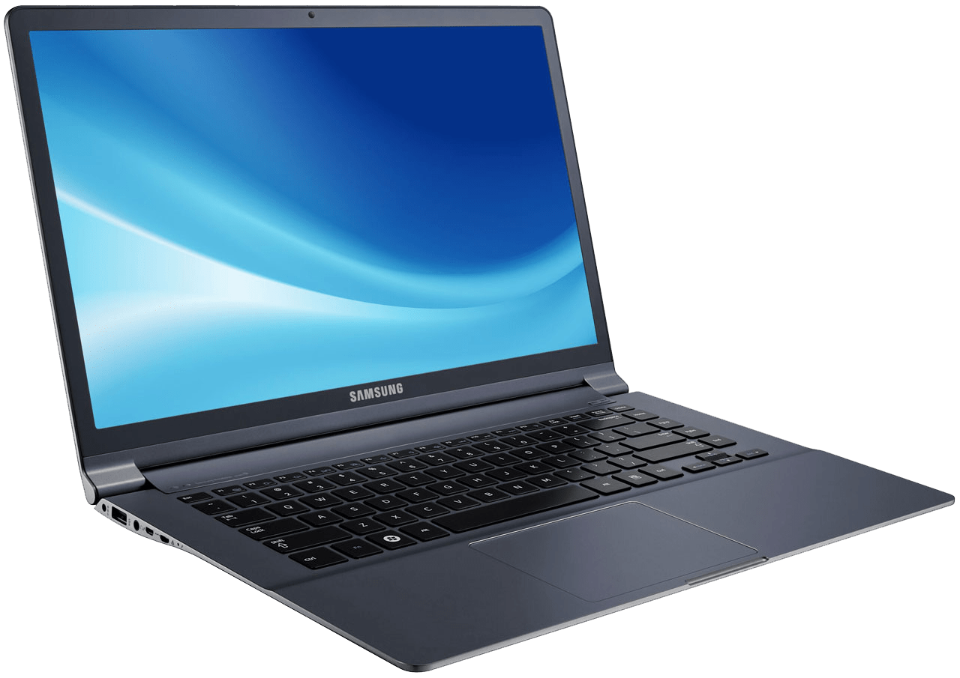
How does the web work?
Domain name URL request
DNS server
Browser
Web Page
IP @
API
http: control commands
Data Center
Cell Tower
Request to access to a particular website
Signals
Particular server
Web Page
SSD
Data via optical fibers
Home Router
Signals

Slide 3
What do you need to be a web developer?
Text editor to write the code (exp: Visual Studio Code)
Browser to preview the aplication ( exp: Google, VS Code)
Repository Manager and a version control (exp: Git, GitHub)

Slide 4
Why did you choose to learn web development?
Development needs creativity and innovation
Development makes us challengers
One of the most demanded jobs in Tunisia and abroad
Development makes us autonomous

